Slide 1
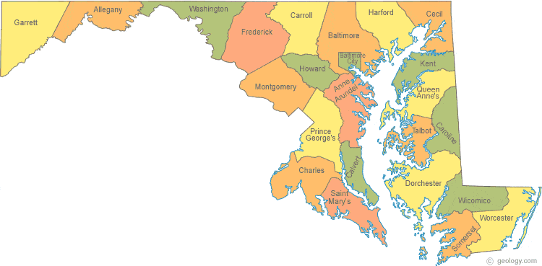
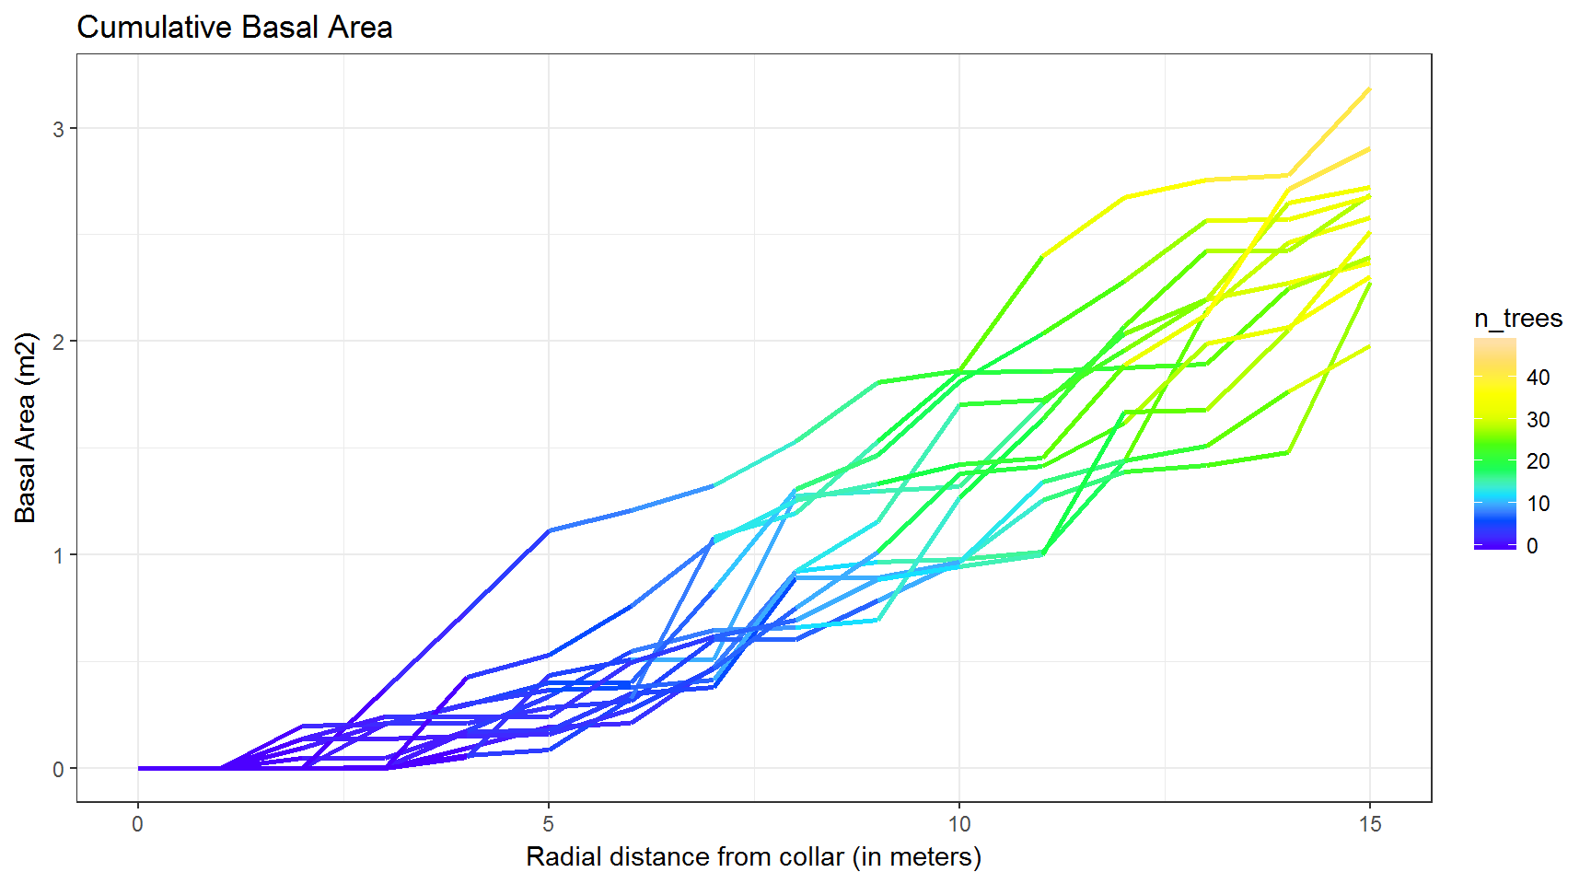
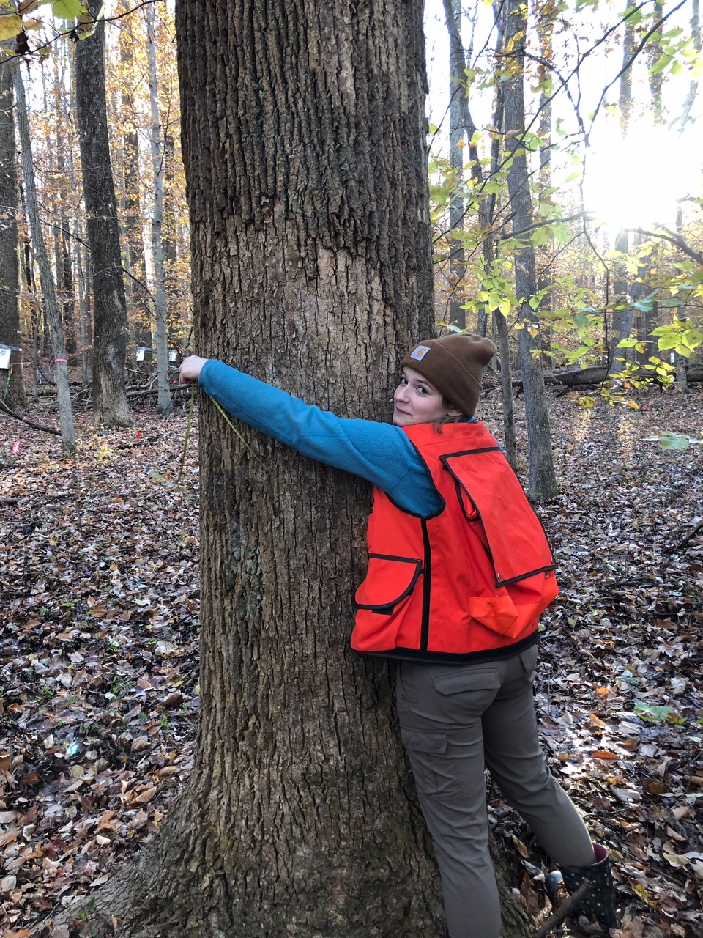
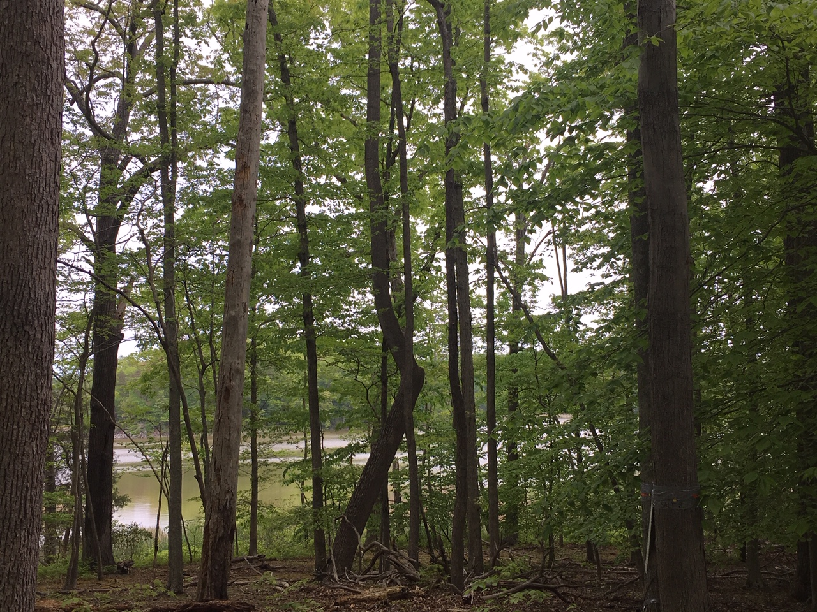
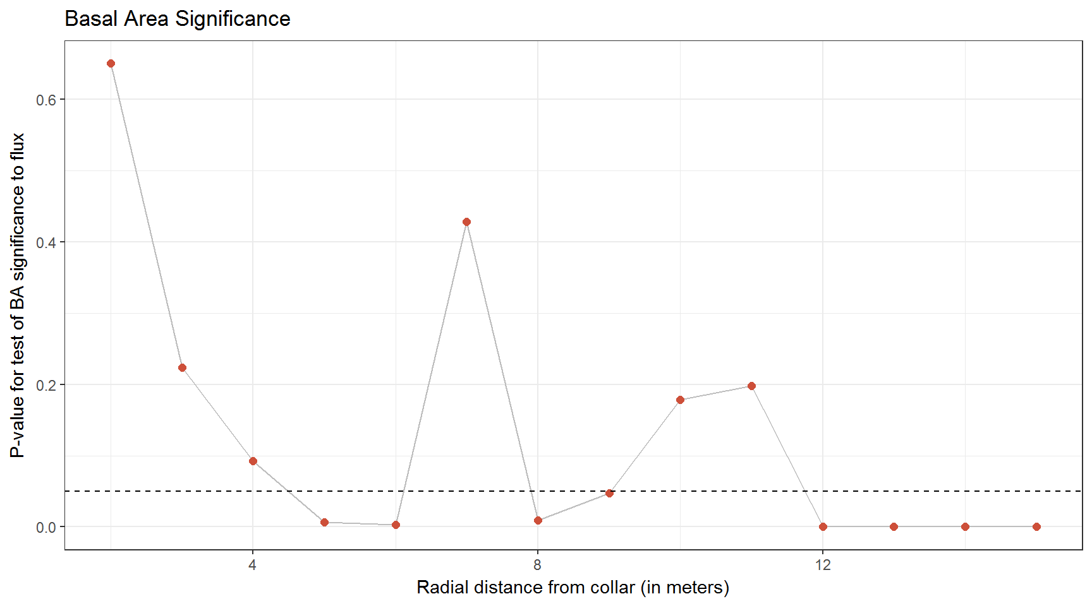
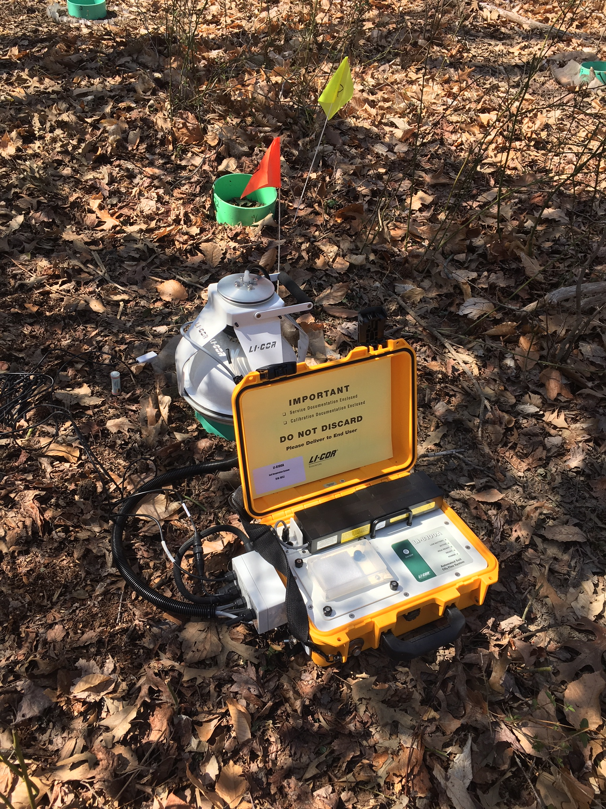
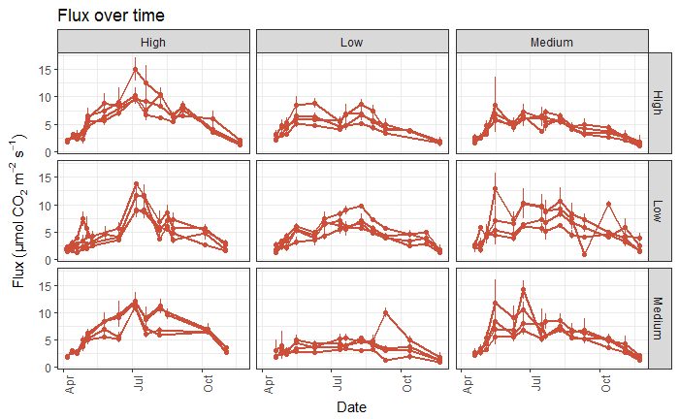
An analysis of tree distribution and spatial variation of soil respiration in a
mid-Atlantic, temperate deciduous forest
Stephanie C. Pennington, Ben Bond-Lamberty
SUMMARY
This study investigates a potential correlation between tree distribution and R_{S} in a mid-Atlantic, temperate deciduous forest, measuring soil respiration along salinity and elevation gradients at three coastal locations 1 km apart.
BACKGROUND
RESULTS
Respiration from soil is a large part of the global carbon cycle and ecosystem
It is also is poorly understood spatially
We chose a mid-Atlantic, temperate, deciduous forest at the Smithsonian Environmental Research Center in Edgewater, MD, USA (see map)
Edgewater, MD
Site | Salinity | Trees (ha⁻¹) | BA (m² ha⁻¹)
SERC | High | 637.5 ± 57.3 | 44.6 ± 4
SERC | Medium | 529.2 ± 93.8 | 40.4 ± 6
SERC | Low | 806.9 ± 180.7 | 34.5 ± 7.8
Table 1 | Study site characteristics, including location (longitude, latitude), basal area (BA), tree density. Values are mean ± standard deviation of N=3 800 m² plots.
Figure 2 | Cumulative basal area for each collar up to 15 meters; the color indicated number of trees at each distance.
We hypothesize…
the amount of basal area close to collars would exert a significant and positive effect on measured R_{s} after the effects of abiotic drivers
this effect would occur in the growing season, but not in the dormant season, and
this effect would be stronger in moisture-limited times of the year, when trees maintained access to deep soil moisture.
Flux = Temp_{20 cm} + Temp_{5 cm} + SMoisture² + SMoisture + BA
Variable | Estimate | SE | Statistic | P-value
(Intercept) | -0.413 | 0.213 | -1.940 | 0.053
Temp 5cm | 0.025 | 0.008 | 3.123 | 0.002
Temp 20cm | 0.065 | 0.008 | 7.753 | 0.000
Soil Moisture | 3.609 | 1.068 | 3.380 | 0.001
I(SM^2) | -6.416 | 1.506 | -4.259 | 0.000
Basal Area | 0.191 | 0.069 | 2.754 | 0.006
METHODS
Soil respiration, along with temperature and moisture, was measured using an infrared gas analyzer (LI-8100A, LI-COR Inc., Lincoln, NE) with a 20 cm soil chamber attached
Measurements were taken every 10-14 days (Figure 1)
Distance from the center of each collar to surrounding trees within a 15 meter radius was recorded, as well is DBH and species
We used a linear model to examine the effect of tree proximity on R_{S} in both the growing and dormant seasons
Table 2 | Linear model output statistics for each variable.
Figure 3 | Significance of basal area at each distance from center of collar.
CONCLUSIONS + FUTURE WORK
Basal area is positively correlated with flux within 5 meters of the soil collars
Spatial structure of the forest should be taken into account when sampling CO2 flux
We plan to subset the flux data to compare between growing season, dormant season, and moisture-limited times
File Name // File Date // PNNL-SA-#####
Figure 1 | Mean flux over time from April 2018 to November 2018 for four control collars at nine sites of varying salinity and elevation levels.
Notes:
NOTE: Print this poster file at 100% SCALE to result in a physical print measuring 48” wide x 36” tall. All type size notations shown above are based on the final printed size of the poster.
• Contact Digital Duplicating (375-2969, http://digitalduplicating.pnl.gov) to order poster printing and finishing services for your completed poster design.
• Remember to have your poster cleared for public display/distribution through the Information Release system (http://informationrelease.pnl.gov).
• Sidebar “About PNNL” box is considered optional, and can be removed if space is needed for technical content.

